Slide 1
Data manipulation in R (using dplyr)

Slide 2
Outline
Describe the purpose of the dplyr and tidyr packages.
Select certain columns in a data frame with the dplyr function select.
Select certain rows in a data frame according to filtering conditions with the dplyr function filter .
Link the output of one dplyr function to the input of another function with the ‘pipe’ operator %>%.
Add new columns to a data frame that are functions of existing columns with mutate.

Slide 3
Bracket subsetting is handy, but it can be cumbersome and difficult to read, especially for complicated operations.
dplyr is a package for making tabular data manipulation easier.
It pairs nicely with tidyr which enables you to swiftly convert between different data formats for plotting and analysis.
This is not the only way to do these things.
Notes:
Packages in R are basically sets of additional functions that let you do more stuff. The functions we’ve been using so far, like str() or data.frame(), come built into R; packages give you access to more of them. Before you use a package for the first time you need to install it on your machine, and then you should import it in every subsequent R session when you need it. You should already have installed the tidyverse package. This is an “umbrella-package” that installs several packages useful for data analysis which work together well such as tidyr, dplyr, ggplot2, tibble, etc.
The tidyverse package tries to address 3 common issues that arise when doing data analysis with some of the functions that come with R:
The results from a base R function sometimes depend on the type of data.
Using R expressions in a non standard way, which can be confusing for new learners.
Hidden arguments, having default operations that new learners are not aware of.

Slide 4
Different dataset ‘shapes’
The package tidyr addresses the common problem of wanting to reshape your data for plotting and use by different R functions
Sometimes we want data sets where we have one row per measurement. Sometimes we want a data frame where each measurement type has its own column, and rows are instead more aggregated groups.
Moving back and forth between these formats is nontrivial, and tidyr gives you tools for this and more sophisticated data manipulation.

Slide 5
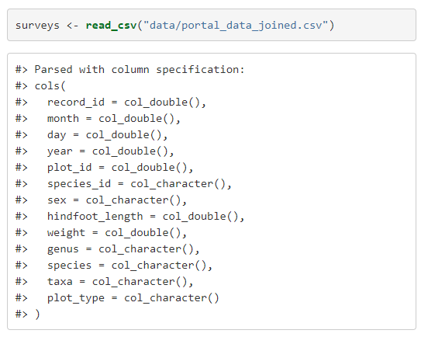
Reading-in data
Instead of the base R read.csv (with a dot), we’ll use the read_csv (with underscore)
Eg

Slide 6
Tibbles
Tibbles tweak some of the behaviours of the data frame objects we introduced in the previous episode.
The data structure is very similar to a data frame. For our purposes the only differences are that:
In addition to displaying the data type of each column under its name, it only prints the first few rows of data and only as many columns as fit on one screen.
Columns of class character are never converted into factors.

Slide 7

Selecting columns
In base R we can select column by integer index or name
In dplyr, to select columns of a data frame, use select().
The first argument to this function is the data frame, and the subsequent arguments are the columns to keep.
To select all except certain ones, use ‘-’

Slide 8

Selecting rows
In base R, we select rows by index
In dplyr, we choose a row by specific criteria using filter
Eg

Slide 9
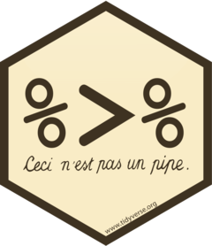

Pipes
What if you want to select and filter at the same time?
There are three ways to do this:
use intermediate steps
nested functions
pipes
With intermediate steps, you create a temporary data frame and use that as input to the next function, like this:
Notes:
This is readable, but can clutter up your workspace with lots of objects that you have to name individually. With multiple steps, that can be hard to keep track of.

Slide 10
Nested functions
Notes:
This is handy, but can be difficult to read if too many functions are nested, as R evaluates the expression from the inside out (in this case, filtering, then selecting).

Slide 11
Pipes let you take the output of one function and send it directly to the next
Useful when you need to do many things to the same dataset
Pipes in R look like %>% and are made available via the magrittr package, installed automatically with dplyr.
Keyboard shortcut is

Slide 12

Eg
Notes:
In the above code, we use the pipe to send the surveys dataset first through filter() to keep rows where weight is less than 5, then through select() to keep only the species_id, sex, and weight columns. Since %>% takes the object on its left and passes it as the first argument to the function on its right, we don’t need to explicitly include the data frame as an argument to the filter() and select() functions any more.
Some may find it helpful to read the pipe like the word “then”. For instance, in the above example, we took the data frame surveys, then we filtered for rows with weight < 5, then we selected columns species_id, sex, and weight. The dplyr functions by themselves are somewhat simple, but by combining them into linear workflows with the pipe, we can accomplish more complex manipulations of data frames.
If we want to create a new object with this smaller version of the data, we can assign it a new name:

Slide 13
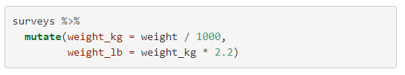
Mutate
Frequently you’ll want to create new columns based on the values in existing columns, for example to do unit conversions, or to find the ratio of values in two columns
In base R we could use cbind() or data.frame()
In dplyr we’ll use mutate()
E.g.

Slide 14
Split-apply-combine data analysis and the summarize() function
Strategy in which
Split: Split the data into groups based on some criteria thereby creating a GroupBy object. (We can use the column or a combination of columns to split the data into groups)
Apply: Apply a function to each group independently. (Aggregate, Transform, or Filter the data in this step)
Combine: Combine the results into a data structure

Slide 15
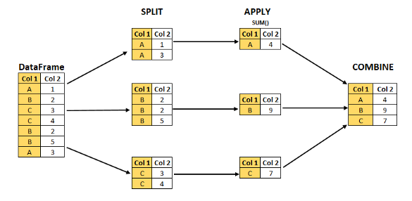

Slide 16
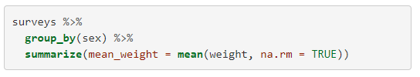
Summarise function
group_by() is often used together with summarize(), which collapses each group into a single-row summary of that group.
group_by() takes as arguments the column names that contain the categorical variables for which you want to calculate the summary statistics.
So to compute the mean weight by sex:

Slide 17
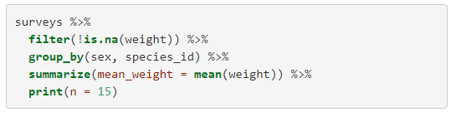
You can also group by multiple columns, subset and control how the output is printed:

Slide 18
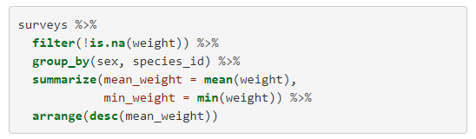
Rearranging columns
It is sometimes useful to rearrange the result of a query to inspect the values.
To sort in descending order, we need to add the desc() function. If we want to sort the results by decreasing order of mean weight.

Slide 19


Counting
When working with data, we often want to know the number of observations found for each factor or combination of factors.
For this task, dplyr provides count().
For example, if we wanted to count the number of rows of data for each sex, we would do:
Same as

Slide 20

Also works for combinations of factors
Eg

Slide 21
Exporting data (the dplyr way!)
Similar to write.csv() use write_csv()
We can create new directories to save our data to from inside of R
First check whether it already exist or not
dir.exists(paths)
Then create a new folder
dir.create(path)

Slide 22
Melt and cast in reshape2 package
Equivalent to gather and spread in dplyr

